Slide 1
August 17, 2018

Slide 2
New GEE file: Crop Dates Statistics v4
5km stratified samples of plant, harvest, peak dates for 2003-2016 pooled, 25km radius
Because of the large number of points, this version has to export csvs in chunks, uses a for loop to do so
New GEE file: Modis LST QC
Extract 2003-2015 daily Modis LST product quality bands (to determine if a day is cloudy)
Focused on mandatory QA flag, took out 00, 10 and everything else flags

Slide 3
Percent cloudy vs clear days per month for Xavier points

Slide 4
GEE Code: Forest Sample v2 (adapted from Jake’s code Forest Sample)
Calculate top of atmosphere and Xavier measured ground radiation for Xavier points from 2000 to 2015 and exports them as csv
Use toa and ground radiation to get a “radiation fraction”
Use a literature-based “percent days with clear sky in dry season” (70%) to get the threshold radiation fraction corresponding to 70% (i.e. 70% of radiation fraction will be less than this threshold radiation fraction)
Take only points that are inside Cerrado biome using the following shapefile: http://data.globalforestwatch.org/datasets/brazil-biomes

Slide 5
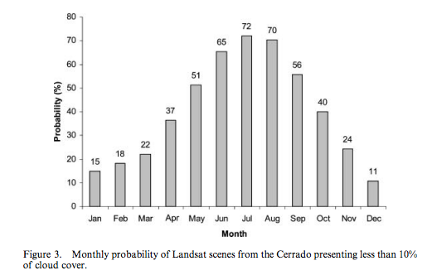
Probability of dry season cloud free days: let’s say June to August. Average is 69%
Source: https://www.tandfonline.com/doi/pdf/10.1080/01431160600981517?needAccess=true
(Sano et al, 2007)

Slide 6
Plant/Harvest date estimation

Slide 7
Summary of common issues with plant/harvest estimates and why they’re bad:
Plant/harvest date were earlier than expected, given shape of EVI curve; maybe issue with land use map or with my estimation method for plant/harvest (i.e. I need to make my plant estimates earlier)
No pixels in polygon but there’s still an estimate somehow… need to get rid of these polygons
Not enough RS data to get a good curve
Reported plant/harvest doesn’t make sense given EVI curve… maybe because of bad land use map or due to reporting error
Very few pixels in the polygon… land use map issue?
Sometimes I mistake the second peak for the first peak
To fix:
New RS data
New land use map
Adjust my plant/harvest
Get rid of empty polygons
Revisit peak/quarter period timing estimation method for different regions?

Slide 8
TO DO

Slide 9
For plant/harvest validation:
Look at performance of estimates/% of bad pixels in polygon wrt reported total area vs. agricultural area in the survey, and also wrt Jake’s land cover map
look at why certain points are so badly estimated.
Test estimating plant dates earlier since a lot of plant dates are estimated to be later than actual
Start new tester script to compare Jake’s % agri to Matopiba reported % agri – look at their match to see how good the land use map is
Does timing of harvest relative to EVI TS change depending on single/double crop?
Get polygons of natural vs planted area for CAR polys - Included with the raw CAR parcel polygons are a set of polygons containing area in native vegetation. You can find those files in, `/cluster/tufts/cohnlab/brazil_car/data/source/<municipality_code>.zip/VEGETACAO_NATIVA.zip`. The car does not provide information on planted acres, though. That will need to come from somewhere else.
Add on mapbiomas cropland layer in addition to Jake’s map to get cropped areas
Ask: are high error areas close to each other?
Compare discrepancy in errors between single vs double cropped pixels/polygons
Are all pixels within a CAR polygon single vs double cropped, or is there a mixture within a polygon?
Is there correlation between the width of the reported range and the error?
Map the max – min (amplitude) of plant/harvest dates from 2003 to 2016 for a given pixel or region
The polygons never change, but we know productive area changes and you are already using mapbiomas to track those changes. thus, I think a good strategy is to estimate planting dates over a) the intersection of Mapbiomas crop and CAR productive area and b) the intersection of Mapbiomas crop or Mapbiomas crop/pasture and CAR productive area this will be more restrictive than just Mapbiomas. Restinga is sandbank/ephemerally flooded area – mask it out.
Will need to revisit GEE file “Land Use Classification” and continue uploading assets of the CAR polys – stopped after only two out of 42. Then combine each type of land use polygon across all munis and mask out plant/estimate image accordingly.
NEED to propagate error due to incorrect underlying land use.
Pin down how to select for agri pixels (test the land use classification with CAR polygon natural veg poly)
Don’t spend too much more time fine tuning estimations to these methods

Slide 10
To improve peak, quarter period, plant, harvest estimates:
Gabriel (or someone) will produce a range of plant/harvest ranges for each state of Brazil
use these ranges to make sure peak estimates are within the range; replace peak values with a new number if not
Snap crop cycle length to a default if it’s out of bounds
Define the tolerance of an estimated plant/harvest date, and “snap” estimates to the end of the reported window if they’re bad
Look up triple co-location (adding new satellite data to triangulate plant/harvest estimate)
Meeting with Ashok
He suggests meeting with Michael d Sohn at lbl (mdsohn@lbl.gov) for causal stats coaching
Why aren’t we looking at plant data in the US?
In addition to using NDVI peak and inflection to determine planting/harvest, use temperature to adjust the distance from inflection point to planting date?
Use soil moisture to see when it rained instead of rain data, to stay in high resolution
Are farmers slamming to one edge of the accepted credit-planting window to meet the insurance requirements for planting window?
Labor shortages, machine rentals, etc all affect planting date

Slide 11
Tests/validation methods for plant/harvest estimates:
From (Urban et al, 2018):
Calculate RMSE, bias, correlation (for interannual variability – R2 and Pearson correlation) and map them to see any spatial patterns in error
Relate bias to season’s avg rain and T, and to fraction natural vegetation to see how error is affected by those factors
Compare estimated plant anomaly (year’s estimated plant date minus average estimated plant date) to actual anomaly. Compare how well anomalies are correlated. And look at how well the estimated spatial pattern of interannual variability matches the spatial pattern of observed variability. Compare boxplots of estimated vs actual anomalies each year
From (Gao et al, 2017):
Can compare a surveyed plant/estimate to RS-based metrics, like peak time and inflection point. There will be a bias, but hopefully also a correlation (see if they follow the same pattern over time and space)
Plot inflection pt or peak vs plant/harvest data (to see whether peak or inflection point has better correlation with data)
Plot year vs DOY for peak, inflection and plant/harvest data over all polygons – essentially peak, inflection, plant data, harvest data will be separate lines on the same plot
Plot polygon vs DOY for peak, inflection and plant/harvest data over all years (or over individual years) – essentially peak, inflection, plant data, harvest data will be separate lines on the same plot

Slide 12
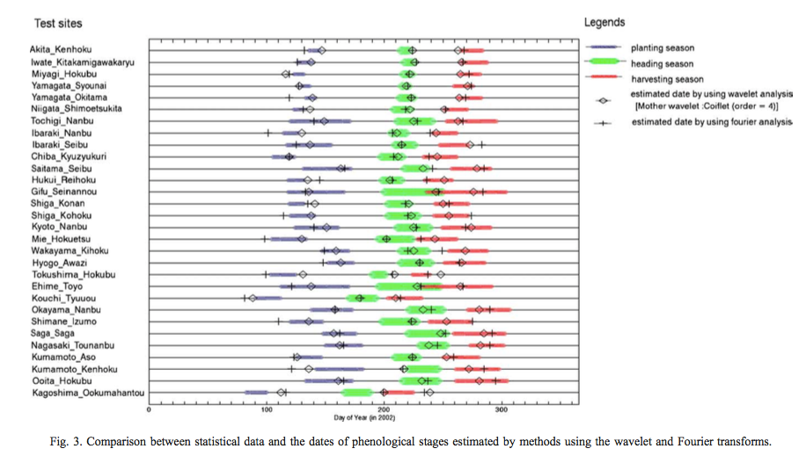
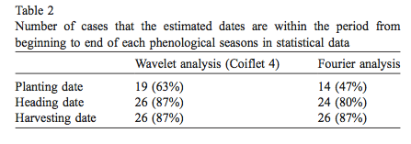
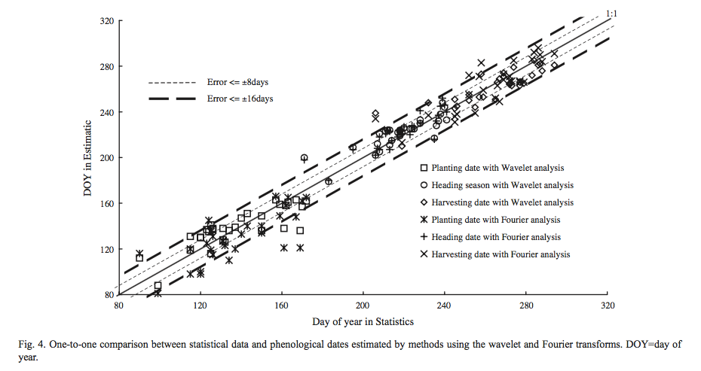
(Sakamoto et al, 2005)
Repeat Fig 4 for growing period (i.e. growing period in data vs growing period in my estimates)
Calculate number of cases (or percent cases) in which estimation error exceeds 16 days
Produce the graphs below
Compare my results to their Table 2

Slide 13
Qual

Slide 14
Form: Higher Degree Committees
Need: exam date
3-5 subject areas (crop modeling, remote sensing, timeseries analysis, causal statistics, land use change)
Committee:
Chair from CEE
ASR (academic senate member) NOT from department
Overall committee must be at least 50% from CEE
Questions about Crop Timing to ask:
How does my estimated peak -> harvest/browndown compare to GDD/thermal time?
For qual, propose the following: (1) plant/harvest date estimation, (2) analyzing plant/harvest date estimation as proxy for farmer behavior over history, (3) something with the statistical crop model.

